Slide 1
Taking on Racial Equity
Angela Russell, MS
Manager, Diversity & Inclusion
Notes:
BEST PRACTICES:
Holding Direct Reports Accountable (executive compensation tied to diversity)
Be a Role Model of Visible, Personal Support (CEO has personal statement about diversity on homepage)
Uphold values at all times (Sr. Executives sit on boards of multicultural nonprofits)
Chief Diversity Officer has frequent access to Senior Leaders
CEO leads Executive Diversity Council
Succession Planning Ensures Support for Diversity

Slide 3
Ground Rules
There will be emotions that are triggered. Breathe and take note about the emotions that are coming up. Take care of yourself.
Use “I” statements.
Be honest and willing to share.
Listen with curiosity and the willingness to learn and change
Suspend judgment. Be open to the wisdom in each person’s story.
Respect for one another, verbal and non-verbal
Confidentiality
Assume good intentions, recognize unintended impacts
Facilitator is not the expert – I am learning, too

Slide 4
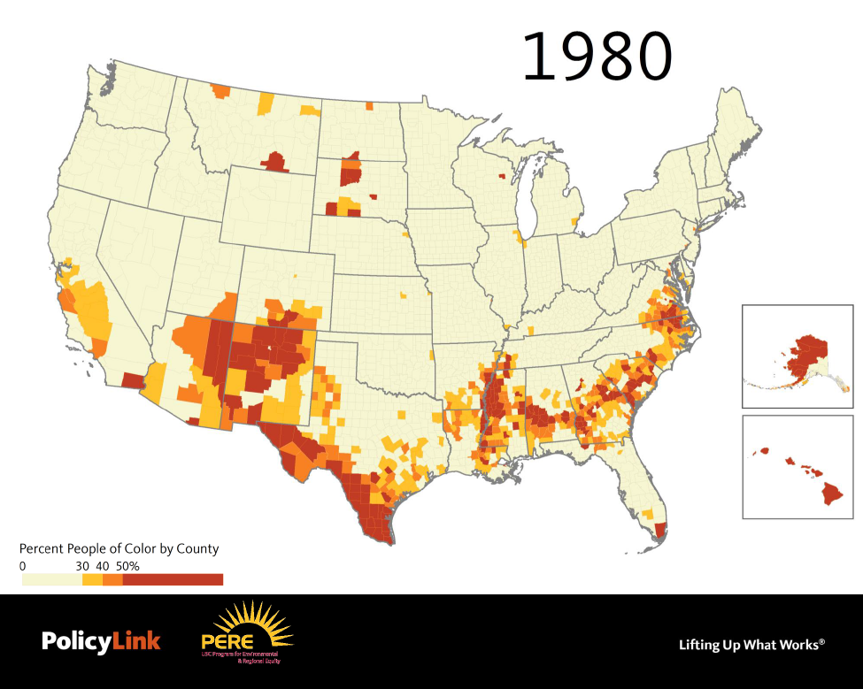

Slide 5
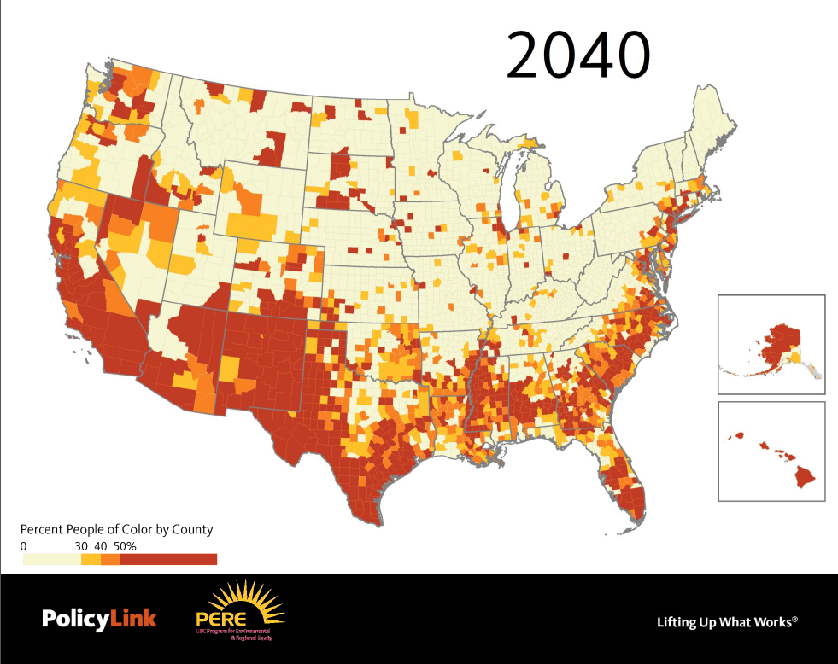
Notes:
Demographic change: “the graying and browning of America”
Projection Dane County will be a majority people of color county by or shortly after 2040

Slide 6
Presentation Goals
Shared understanding of racial equity
Personal goal: What is the one goal that you have for yourself for this presentation or discussion?
Notes:
Colleen

Slide 7
What is racial equity ?

Slide 8
Defining Equity
Equity is just and fair inclusion into a society in which all, including all racial and ethnic groups, can participate, prosper, and reach their full potential. Equity gives all people a just and fair shot in life despite historic patterns of exclusion.
www.policylink.org

Slide 9
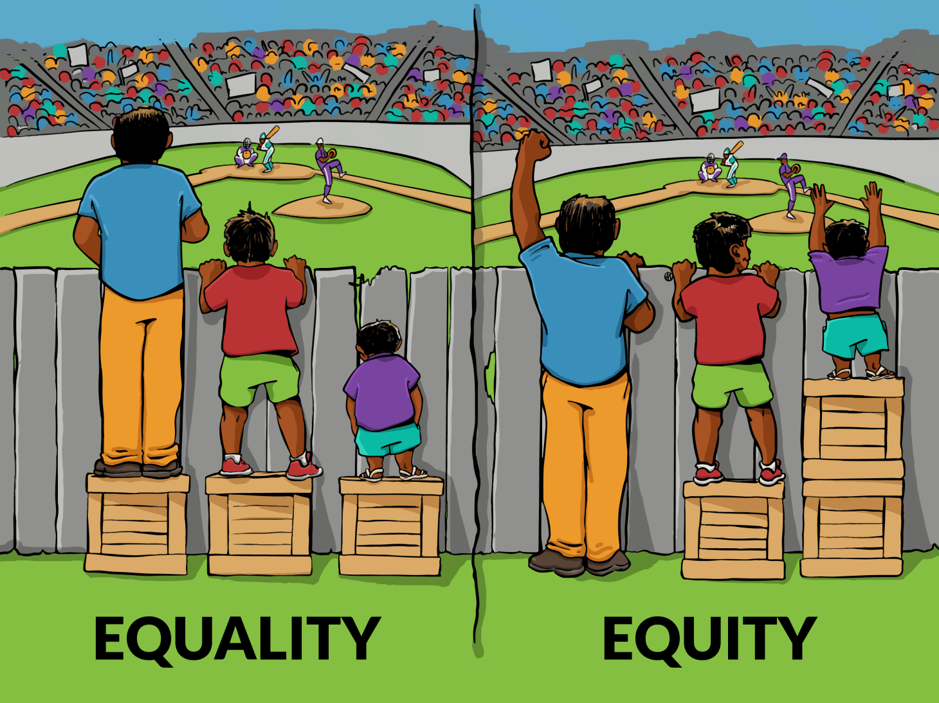
Equality vs. Equity
Source: Interaction Institute for Social Change - http://interactioninstitute.org/illustrating-equality-vs-equity/

Slide 10
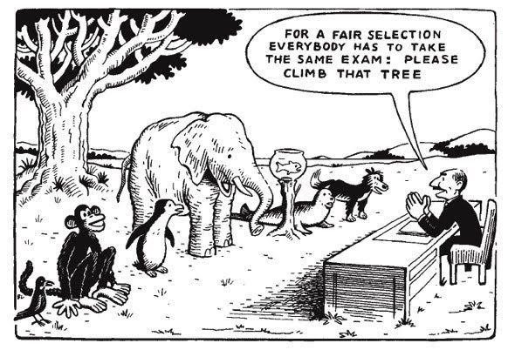
Equality vs. Equity

Slide 11
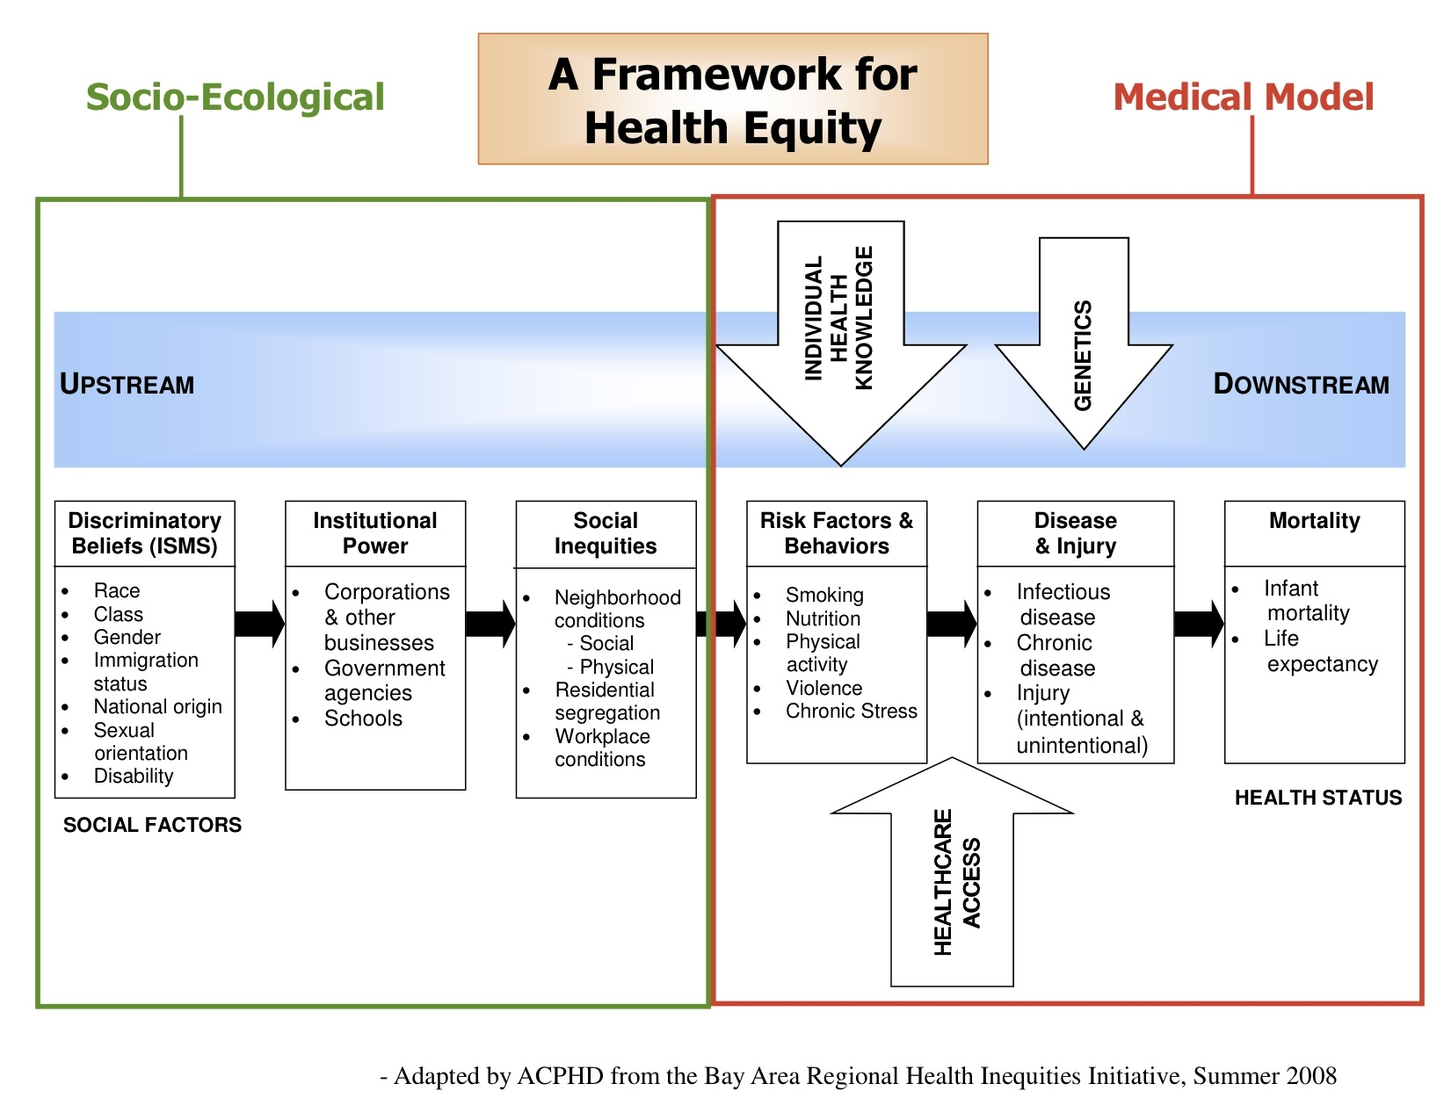
Source: Alameda County Health Department , http://www.acphd.org/media/46517/barhii_chart_20080903.pdf
Notes:
Angela - beliefs … they do not need to be concious

Slide 12
3 Layers of Bias
Structural
Institutional
Individual
1. Individual Bias: Pre-judgment, bias, or discrimination by an individual based on race, gender, sexual orientation, etc.
2. Institutional Bias : Policies, practices, and procedures that work to the benefit of certain people and to the detriment of others, often unintentionally or inadvertently.
3. Structural Bias: A history and current reality of institutional bias across all institutions. This combines a system that negatively impacts people.
Notes:
In many cases, policies have changed, but the effects are lasting. OR policies have been changed but practices still in effect are creating and perpetuating inequities.
Equity Impact work, and our vision, is meant to interrupt all three of these levels, with a focus on the institutional. We focus on racial bias and inequities in our work because we feel it is paramount for our community. That being said, we are considering all intersections of identity.
Individual Example: bus driver routinely asks kids of color to show ID with bus passes; teachers’ expectations of kids of color and their parents
Institutional Example: disproportionate discipline application in schools (detention, suspensions)
Structural Example: school to prison pipeline – kids funneled from school discipline into juvenile and prison systems…ignoring history of unfair treatment, learning disabilities, abuse, poverty, etc…

Slide 14
Characteristics of implicit bias
Implicit biases are pervasive. Everyone possesses them, even people with avowed commitments to impartiality such as judges.
Implicit and explicit biases are related but distinct mental constructs. They are not mutually exclusive and may even reinforce each other.
The implicit associations we hold do not necessarily align with our declared beliefs or even reflect stances we would explicitly endorse.
We generally tend to hold implicit biases that favor our own ingroup, though research has shown that we can still hold implicit biases against our ingroup.
Implicit biases are malleable. Our brains are incredibly complex, and the implicit associations that we have formed can be gradually unlearned through a variety of debiasing techniques.
Source: Kirwan Institute for the Study of Race and Ethnicity
Notes:
These things ignored or left unchecked lead to poor decision making and inequities. This stuff leads to 6 bullets.

Slide 15
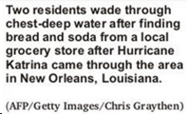
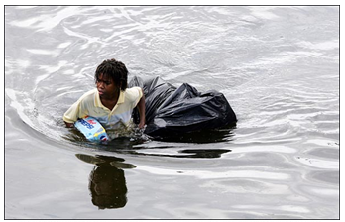
Notes:
We need to pay attention to how issues are framed and communicated.
As a field, we can do better in this area in making sure we talk in the language of root causes and identify bias in the way we and others

Slide 16
Identifying and Addressing Implicit Bias
Recognize that we all have it – no one is immune.
Make the implicit explicit – take the IAT.
Participate in implicit bias trainings and diversity seminars.
Evaluate current media sources and consumption.
Get feedback back from a trusted colleague.
Improve conditions for decision making – thinking slow.
Intergroup contact.

Slide 17
What does this mean for your work?

Slide 18
Equity within organizations
Build organizational capacity to address racial equity
Create a common understanding of the root causes of racial and ethnic disparities and their possible solutions with a focus on justice and equity
Raise the visibility of current racial equity efforts
Explore and advance policy solutions to achieve equitable outcomes.
Identify, dismantle and prevent institutional and structural racism in agencies and systems
Notes:
Colleen
Regarding organizational capacity to create the conditions.

Slide 19
Common Themes & Emerging Best Practices
High Level Support
Long Term Commitment
Strategic and Systematic Use of Tools
Capacity Building of Staff and Community
Accountability and Transparency via Data & Reporting
Collaboration and alignment with other efforts
Recognition of early wins
Notes:
Angela
Credit Julie & Glenn
This is consistent with our research
These are the things we think we will need to be successful – we have begun to build the framework for this – will need to continue balancing urgency with long-term focus

Slide 20
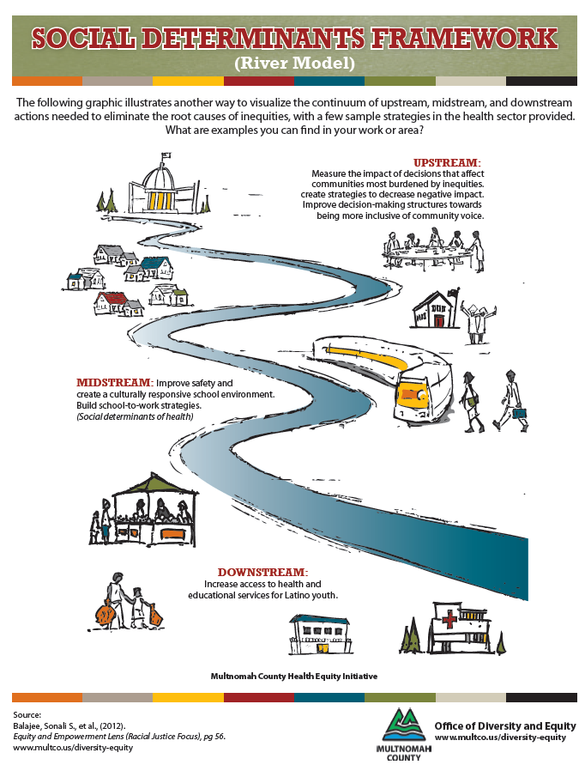
Equity: Addressing root causes
Status quo: Addressing disparate outcomes
Notes:
JB

Slide 21
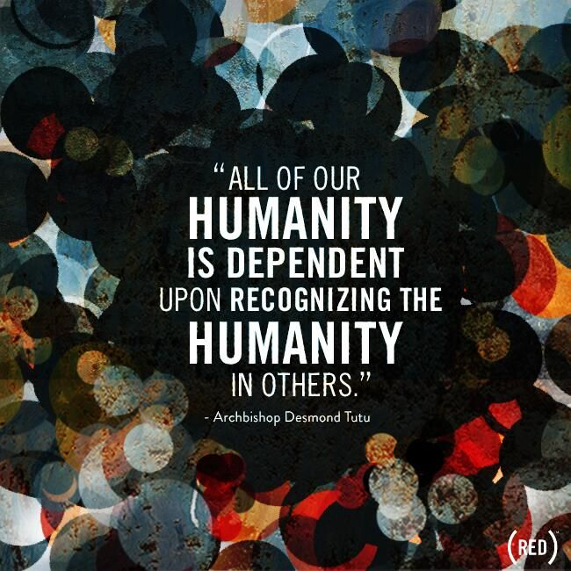
What can we do day-to-day?
Check biases and beliefs – implicit bias assessment
Ask questions
Commitment
Transformation
Continuous learning
Self-care
Actively work towards dismantling systems and structures of inequity in your home, work, and community
Notes:
AR

Slide 22
Starting Points: Resources for Diversity, Equity and Inclusion Work
Implicit Bias Assessment, Harvard University - https://implicit.harvard.edu/implicit/
Cracking the Codes: Unconscious Bias - https://www.youtube.com/watch?v=F05HaArLV44
How to be an ally- http://everydayfeminism.com/2013/11/thingsallies-need-to-know/
The case for reparations, Ta-Nehisi Coates - http://www.theatlantic.com/features/archive/2014/05/the-casefor-reparations/361631/
Detour-spotting - http://www.racialequitytools.org/resourcefiles/olson.pdf
Notes:
AR

Slide 23
Questions to think about
What would “effectively integrating equity” mean for the your organization? What would it look like now, in five years, and in ten years?
What are the costs to you, your organization, and your community if you adopt a plan to tackle racism and other forms of oppression explicitly?
What are the costs of not adopting an explicit approach to addressing inequities?

